Slide 1
Continuous Delivery Pipeline
Aaron Blythe

Slide 2
https://www.youtube.com/watch?v=SIaVsG7m8n4

Slide 3
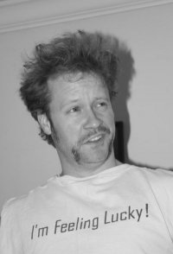
@ablythe
http://www.slideshare.net/aaronblythe
https://github.com/aaronblythe/jenkins_scripts

Slide 4

Notes:
I graduated from UIUC in 2002
I got this from the Way Back machine. My degree is in Industrial Engineering, which at the time was part of the the Mechanical Engineering School referred to as MIE. It is now the Department of Industrial and Enterprise System Engineering referred to as ISE. Things change it is no longer uiuc.edu, it is now illinois.edu. In this major I studied a lot of Manufacturing principles, such as Deming and Shewart’s Charts. So many years ago my formal study was in Manufacturing. I also found out that not only do I like to write code, but I am decent at it.

Slide 5
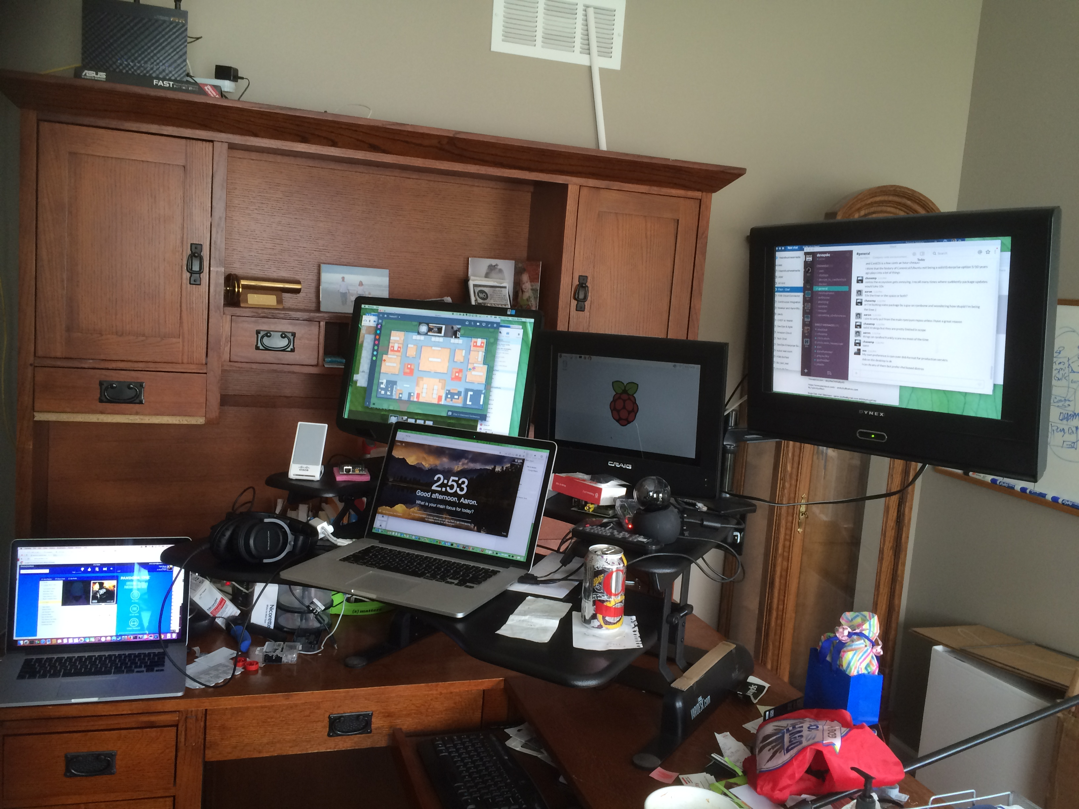
Work Remote
Notes:
I work remotely from my home and I love it.
Here you can see my Varidesk, where I can go from up and down in just 3 seconds.
Pretty sure that is the tag line.

Slide 6
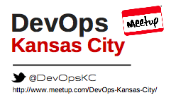
Notes:
I also organize the DevOps Kansas City Meetup.
Our tag line is “providing a place for Devs and Ops to hangout”
We are working on bringing the DevOpsDays 2 day conference to Kansas City later this year in October.

Slide 7





Tools
Source Control
Cloud Platform
Containerization
Continuous Integration/Delivery
Configuration Management
Notes:
I told you a little about me, that you likely did not care about.
Now I would like to hear a couple things about you. These are the tools I plan to use today.
First who here would identify themselves as a developer? As an operator?
Who has used Jenkins? Who has used Chef?
I’m going to walk through a real world example today, but I want to focus more on the why and the lessons.

Slide 8
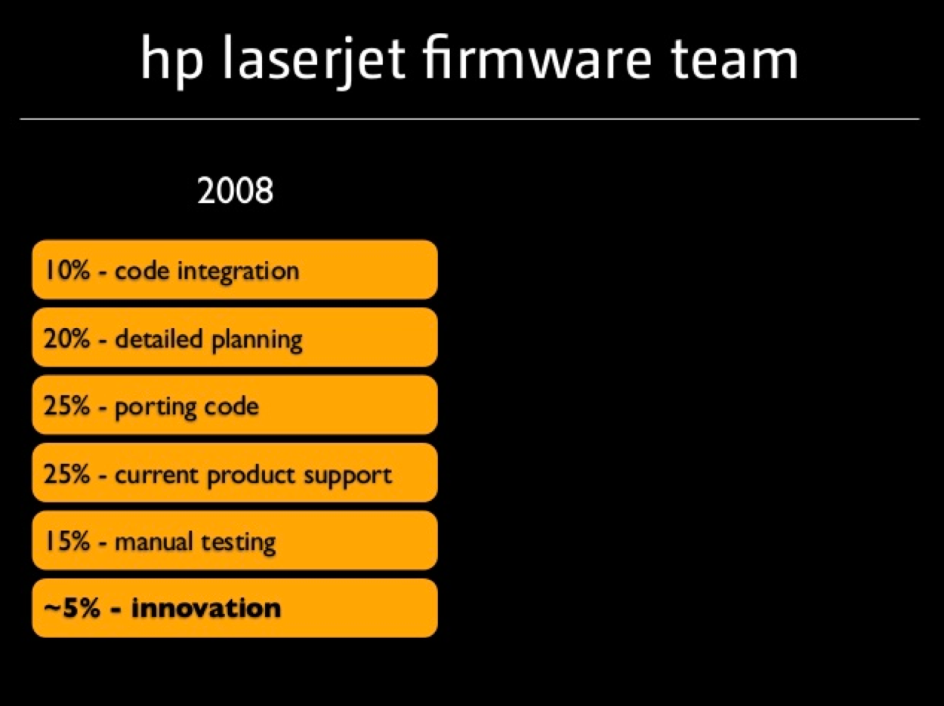
Notes:
Before we get really deep into this, I want to talk about why CD is important.
This was the story at HP. I have lived this before.
http://www.slideshare.net/jezhumble/adopting-continuous-delivery

Slide 9
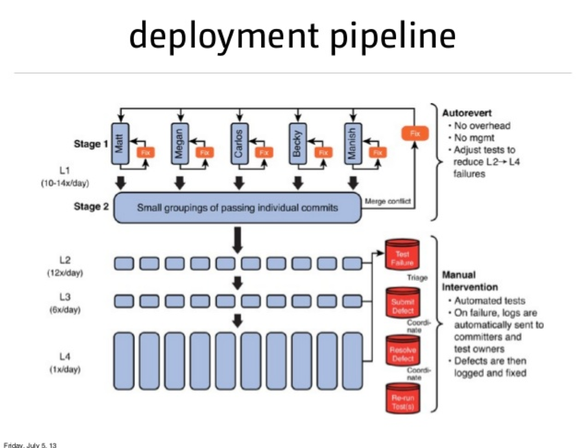
https://twitter.com/ablythe/status/643866472377401344
Notes:
At HP we had 27 products, one branch, 20,000 hours of tests per day.
Potentially they were able to start spending 8X the amount of time on innovation.

Slide 10
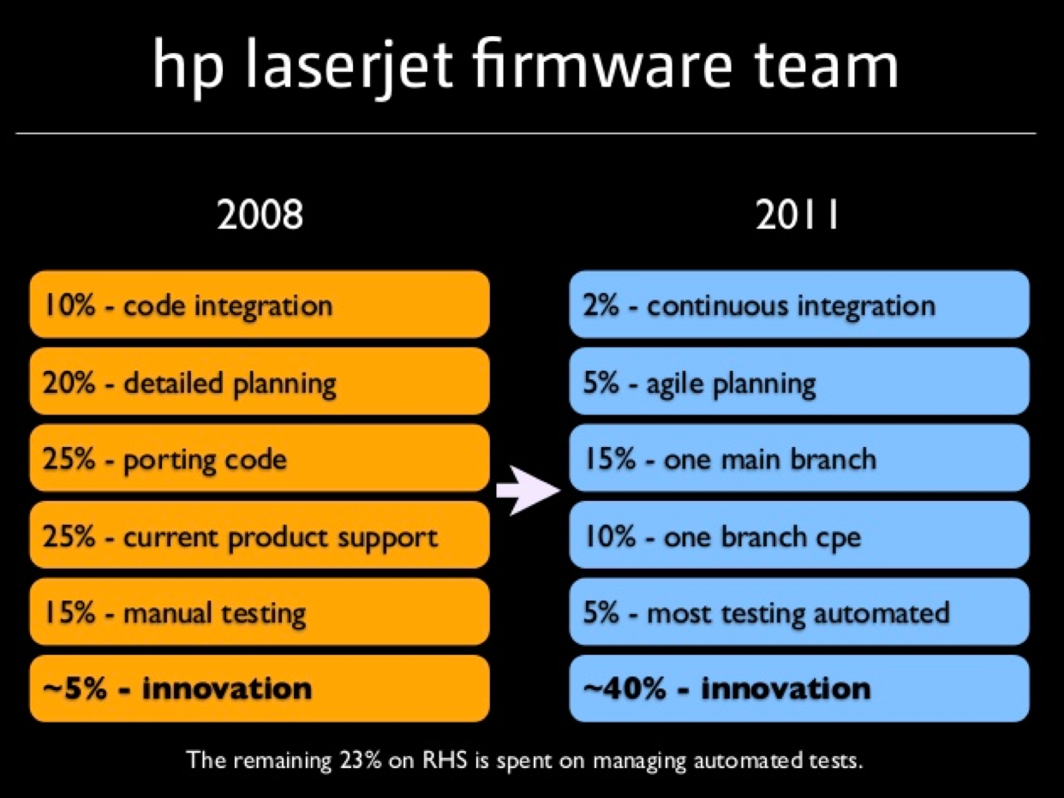
Notes:
That is 8X the amount of time spent on innovation, which is huge.

Slide 11
So when can you say you’re doing continuous delivery? I’d say it’s when you could flip a switch to go to continuous deployment if you decided that was the best way to deliver value to your customers.
http://continuousdelivery.com/2010/08/continuous-delivery-vs-continuous-deployment/
Notes:
What give a lot of people pause is that they believe this is full automation.
What we are shooting for is autonomation

Slide 12
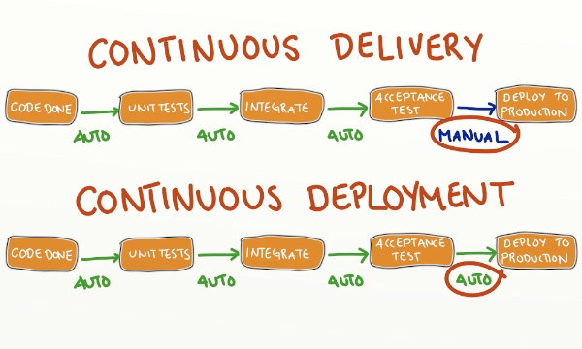
Notes:
We will have manual steps, and I will refer to these as gates possibly.
The thing we want to think about is the entire idea of the software feature tied together. Remember the video of throwing over the walls.

Slide 13

Live Demo
http://www.slideshare.net/aaronblythe
https://github.com/aaronblythe/jenkins_scripts
Notes:
Oh and did I mention I am crazy… i am going to attempt a live demo in front of you all… so let’s see how this goes…
QQQQ - go up to showing running in docker in the browser

Slide 14
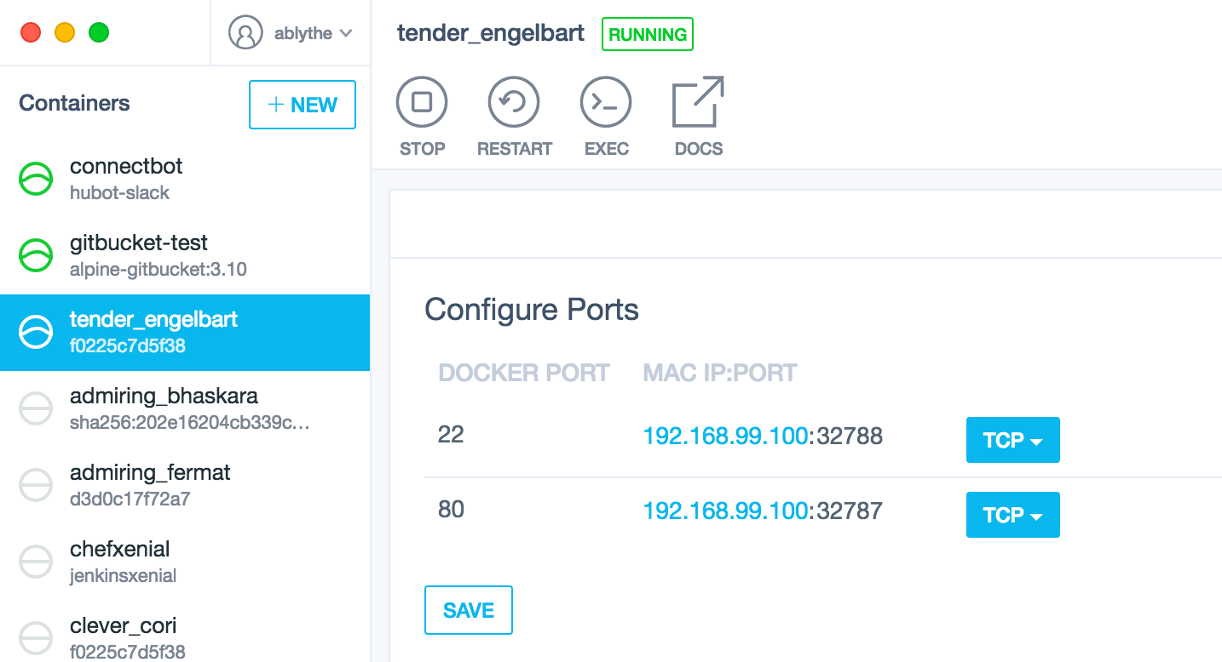
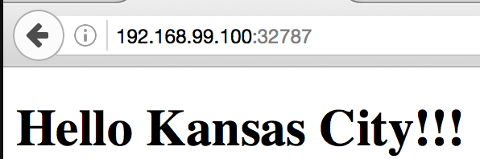
Locally

Slide 15
Points
Test locally matching production as much as possible
Notes:
In this demo I am breaking this rule because I am using the just released Xenial Ubuntu 16.04 in my docker container, but I will be using Trusty Ubuntu 14.04 in a bit on Amazon. I plan to true this up in future versions of this talk and the notes online.

Slide 16
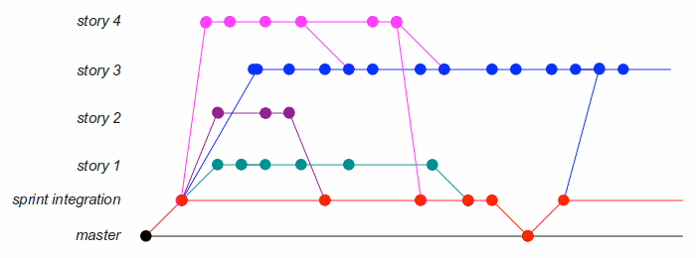
Check In on a Branch
Notes:
This may be where may philosophy differs from others. I feel like you should only ever push to a branch if your system is mature. (I of course break this rule on greenfield and single developer projects where I don’t have a pipeline). But this is my only rule. Keep things simple and push to a branch.

Slide 17
Points
Test locally matching production as much as possible
Everything in Source Control
Notes:
This is one of the most central tenants of DevOps. When people ask me what DevOps tools should I learn. I say Git.

Slide 18

Create Pull Request
Notes:
QQQQQ - Create pull request

Slide 19
Points
Test locally matching production as much as possible
Everything in Source Control
Agree as a team on Branching standards
Notes:
A lot of people like git-flow.
Agree on a team branching (and merging) strategy
Quick Story from Gary Gruver

Slide 20
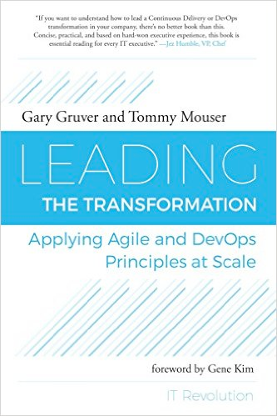
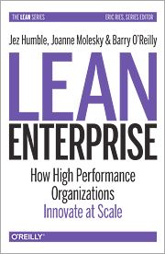
https://medium.com/@aaronblythe/gary-gruver-s-story-at-hp-and-macy-s-5ee89d4bcdc9#.yc1ecomxp

Slide 21
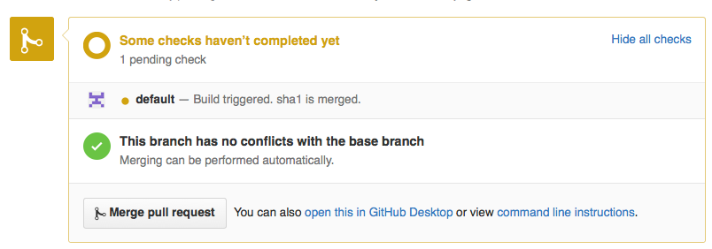
Jenkins Integration to Github
Notes:
Here we see a visual representation of whether this pull request should be merged.
Obviously we want to wait to merge until we have a successful build.

Slide 22
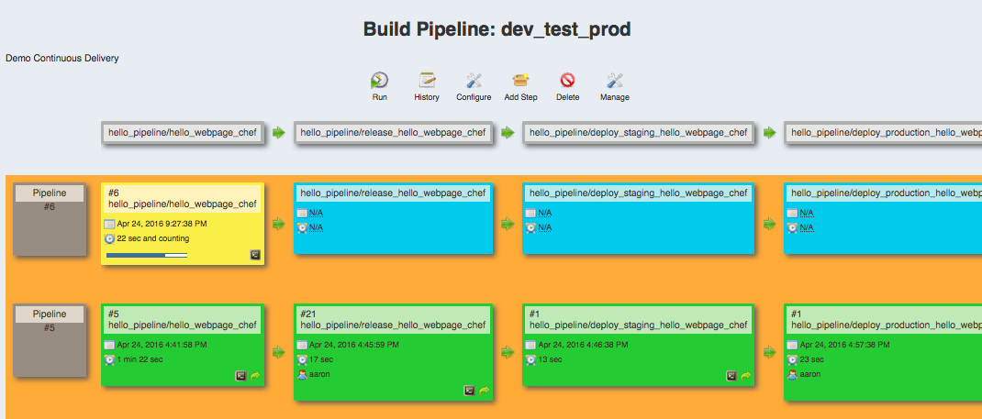
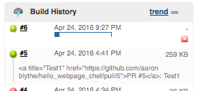
Starting our pipeline from the Pull Request
Notes:
I decided to use the Build Pipeline Plugin because it is visual.
There is also the Pipeline Plugin that is being worked on by the core Jenkins team that offers a DSL in Groovy that is awesome to work with. I am unsure where CloudBees will land on licensing the Pipeline Plugin. There is an experimental visual editor https://github.com/jenkinsci/pipeline-editor-plugin.

Slide 23
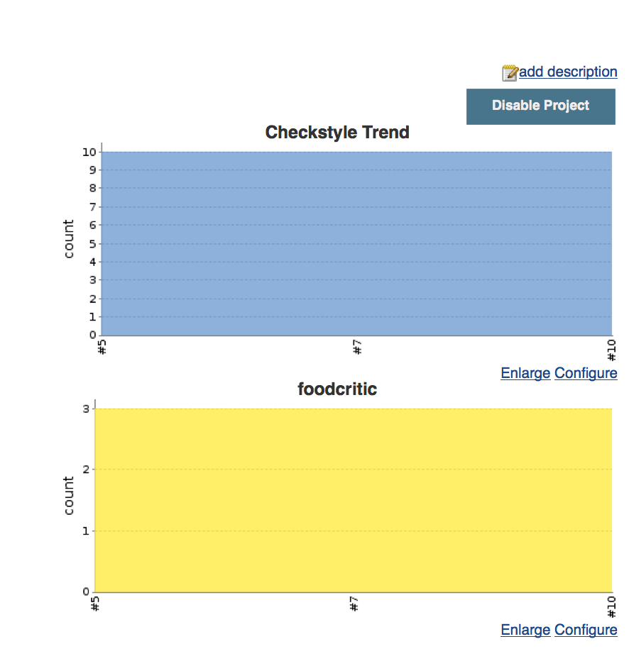
Static Analysis (Linting)
Notes:
I can only imagine it is called linting because of a dryer filter.
It catches all that stuff so your house doesn’t catch on fire.
I currently have not cleaned up all the lint on these projects, but this is something you could potentially stop the pipeline on.

Slide 24
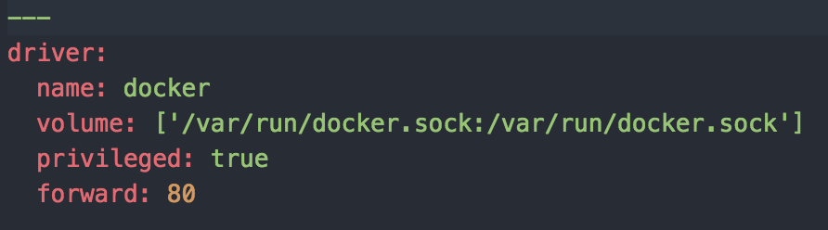
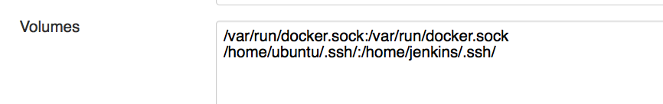

DooD (not to be confused with DinD)
(Trick: mount docker socket)
Kitchen.yml
Docker Cloud
Configuring IP
Jenkins Master
Jenkins Worker
Kitchen Docker
Docker Cookbook
Docker Host
Notes:
Docker outside of Docker

Slide 25
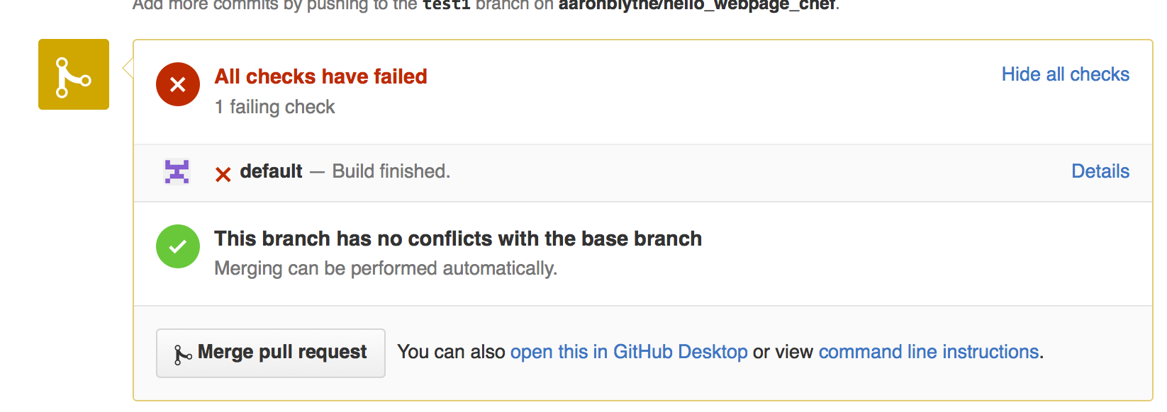
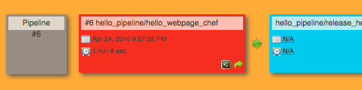
Failed Build!!
Notes:
Oh noes!! Is this where I table flip, drop mic and walk out?

Slide 26
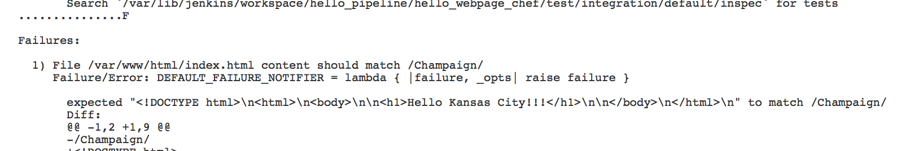
Check the logs of the test
Notes:
QQQQQQ - Fix the test and commit and push

Slide 27
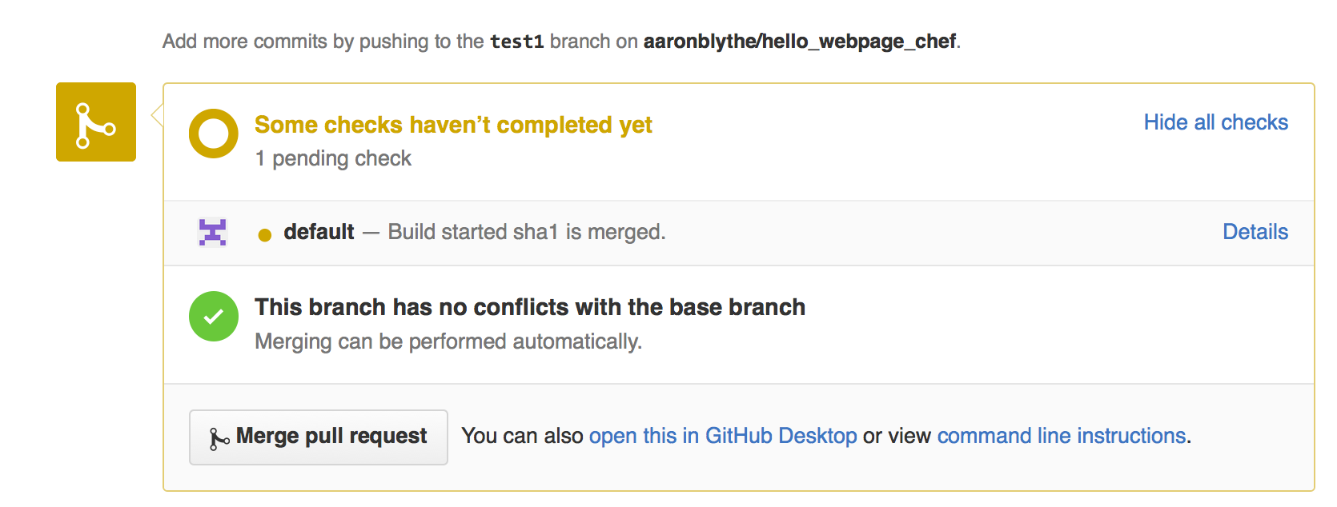
The build should automatically restart

Slide 28
Points
Test locally matching production as much as possible
Everything in Source Control
Agree as a team on Branching standards
Have good tests and coverage
Notes:
Questionable whether my test was good? But if I made a change and Apache was a different version or was not running that would be really good information.

Slide 29
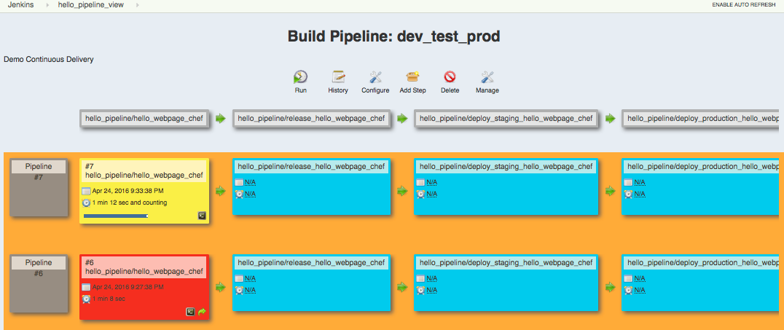
Restart From Next Push to branch

Slide 30
Points
Test locally matching production as much as possible
Everything in Source Control
Agree as a team on Branching standards
Have good tests and coverage
Fix the build right away

Slide 31
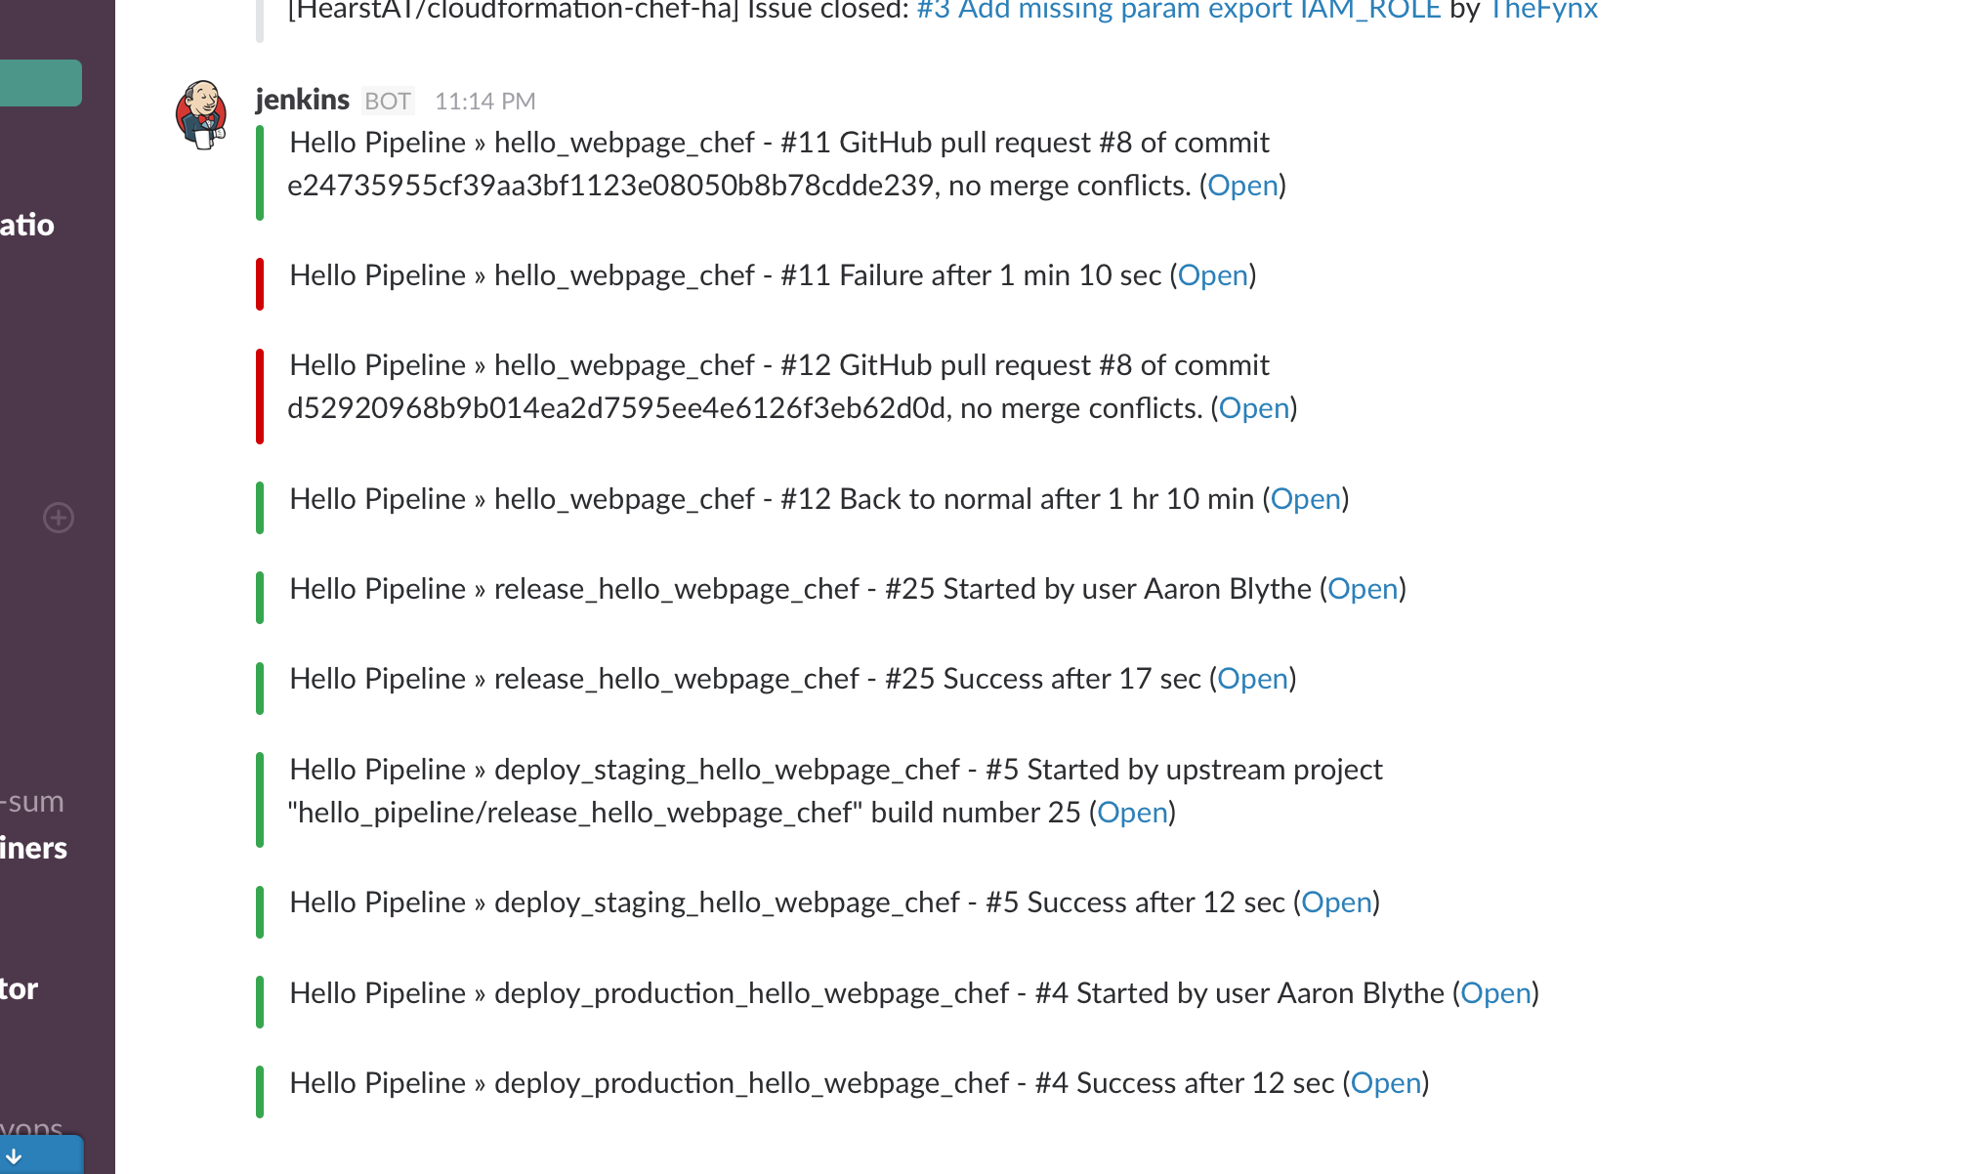
All possible interested users should know
Notes:
So I have the Slack room being updated by each job in the pipeline.
I am using the Slack Plugin for Jenkins which is basically a web hook.
Web hooks are great. Users can enter and leave rooms as they need.
We could go so far as to have failed builds go to PagerDuty.

Slide 32
Points
Test locally matching production as much as possible
Everything in Source Control
Agree as a team on Branching standards
Have good tests and coverage
Fix the build right away
Make things visible

Slide 33
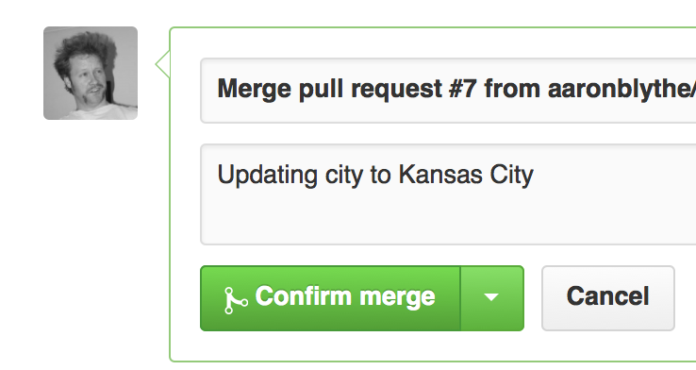
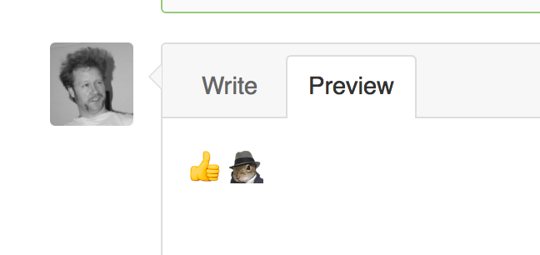
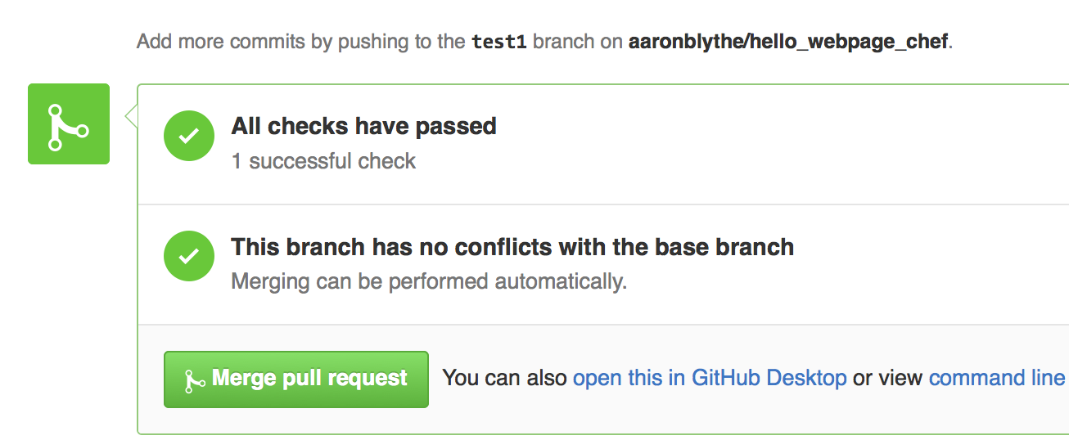
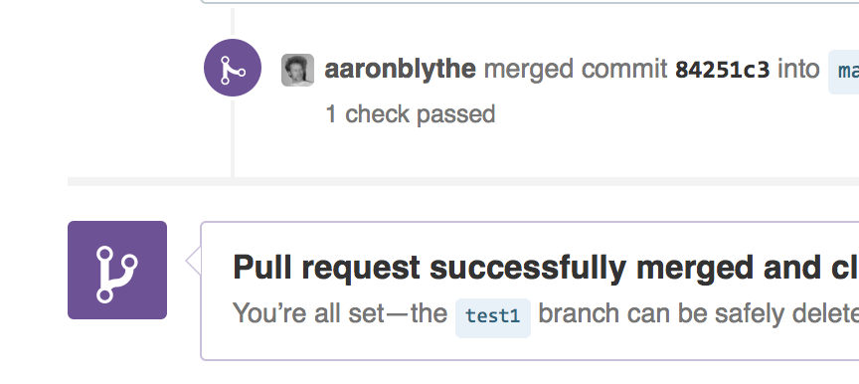
Merge Pull Request
Notes:
Leave a comment.

Slide 34
Go here:
http://stage-deploy-demo.hearst.at/
Notes:
I want you to go here on your phones or tablets or computers or whatever so you see I have no tricks up my sleeve, it says “Hello Kansas City”

Slide 35
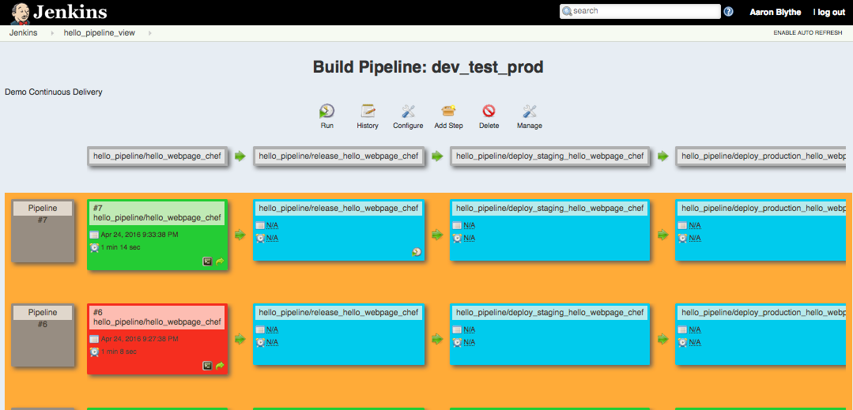
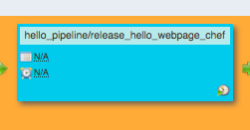
Move On With the Pipeline
Notes:
So the developer is done and maybe this next step is done by someone else.
* Lead Architect (Maybe they were the one with pull request permissions)
Someone is QA
The suits, who knows…

Slide 36
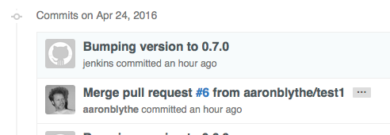
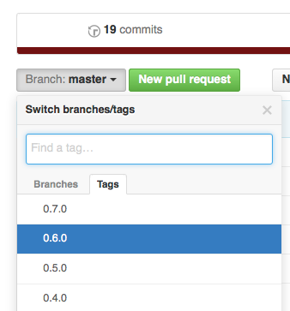
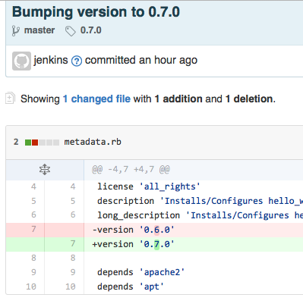
Tag in Github and update necessary version identifiers

Slide 37
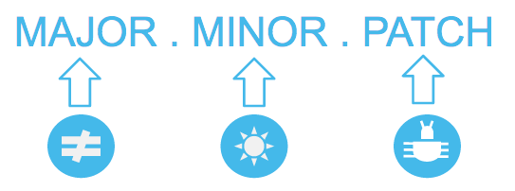
Semantic Versioning
http://semver.org/
Notes:
This is a language.
Major - something changed
Minor - new feature, safe to take
Patch - fix, also passive

Slide 38
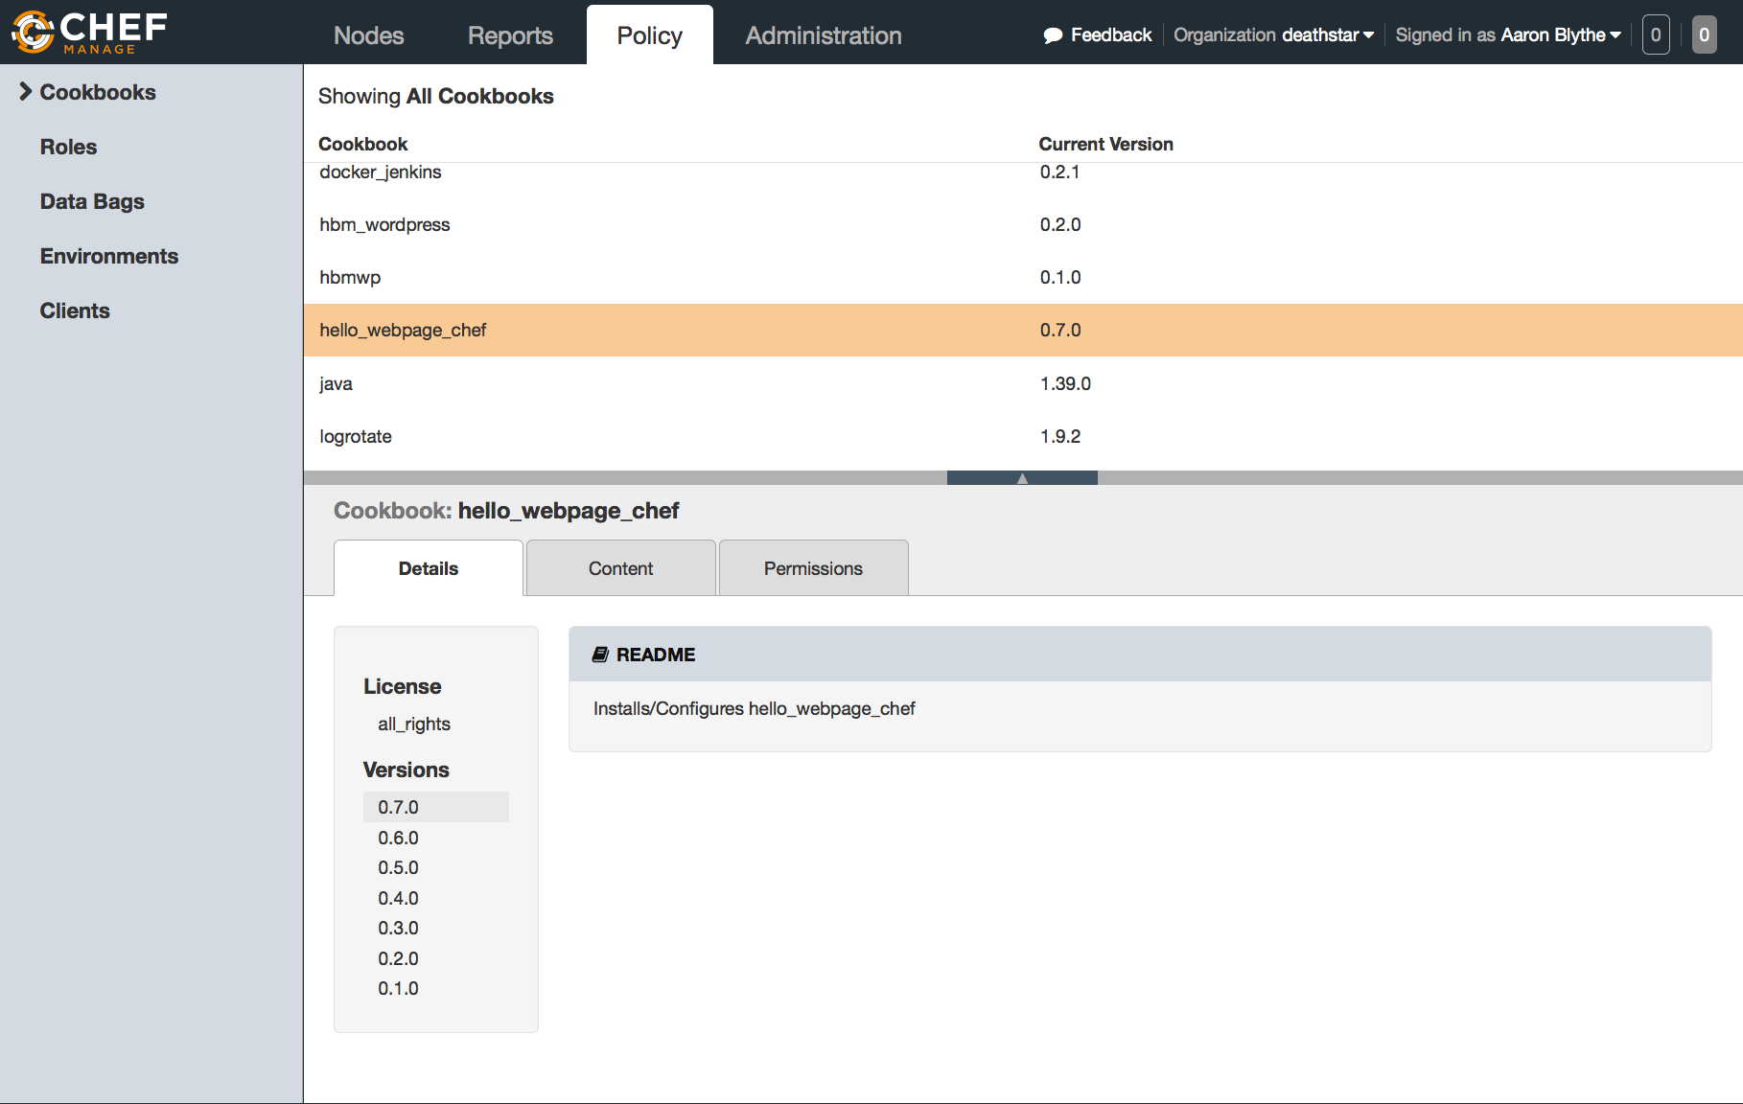
Release to Artifact Repository
Notes:
For me this is the Chef server.
Maybe you are in Java and you use nexus or artifactory.
Or you are building deb’s or rpm’s for linux or dll’s for Windows.
Point is that you want to move the artifacts to a repository that is appropriate (likely not your source code repo).

Slide 39
Points
Test locally matching production as much as possible
Everything in Source Control
Agree as a team on Branching standards
Have good tests and coverage
Fix the build right away
Make things visible
Automate your release process

Slide 40
Promise Theory
Voluntary cooperation between individual, autonomous actors or agents who publish their intentions to one another in the form of Promises.
Quite different than Obligations that we often deal with.

Slide 41
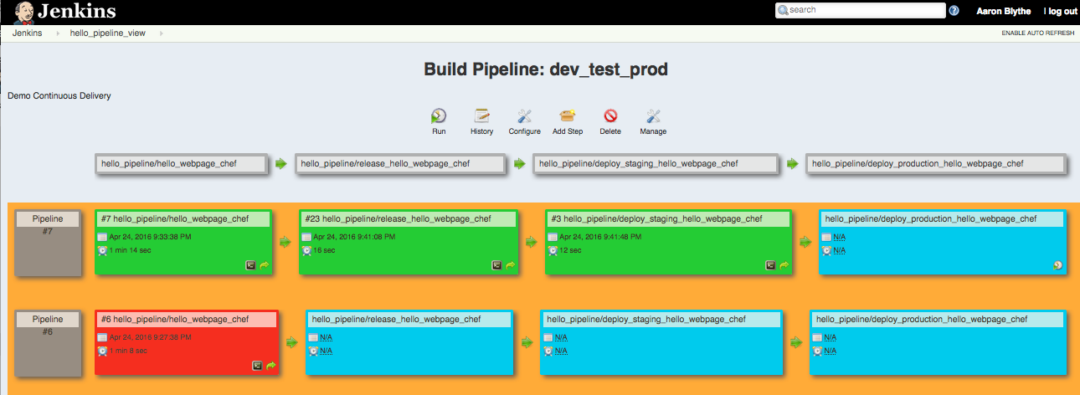
Deploy to Staging

Slide 42
Points
Test locally matching production as much as possible
Everything in Source Control
Agree as a team on Branching standards
Have good tests and coverage
Fix the build right away
Make things visible
Automate your release process
Stage exactly like production
Notes:
Stage like production.
I want this deploy to fail if it is going to.
I want the deploy to Production to be an non-event

Slide 43
Configuration Management
Idempotent (e.g. can run repeatedly and achieve the same result, PUT in HTTP is Idempotent)
No-op when already done before

Slide 44
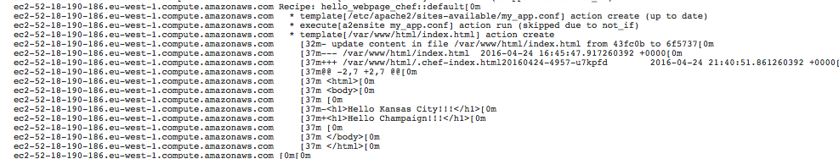
Chef
Notes:
Because I used an already converged node this deployment was wicked fast.
With my simple cookbook and if I had to spin up an EC2 instance this may have taken 5-10 minutes.

Slide 45
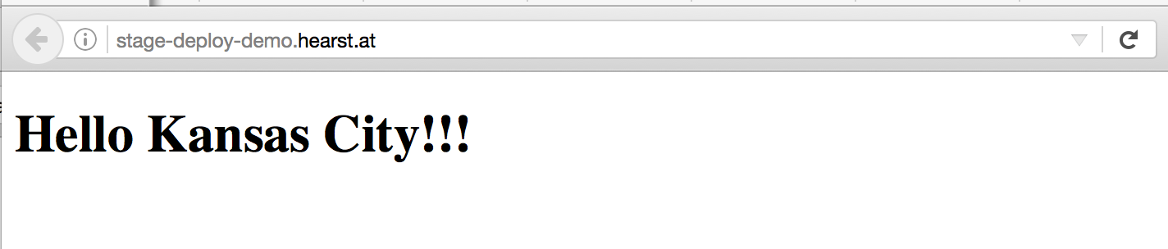
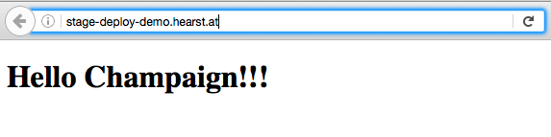
Deploy to Staging
Notes:
While this is in Staging we want to do testing.
This may be manual testing, but my favorite form of testing is automated.

Slide 46
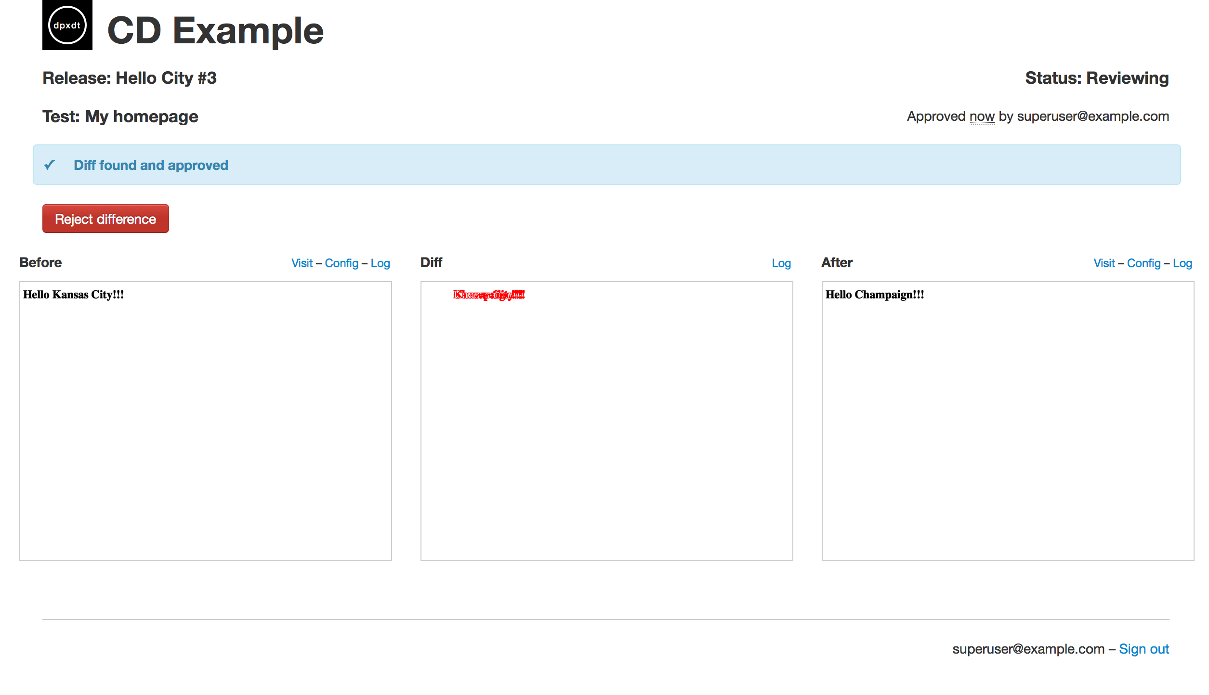
Perceptual Diffs
Notes:
And my favorite form of automated tests are perceptual diffs.
I ran this locally. Go over the pixels.

Slide 47
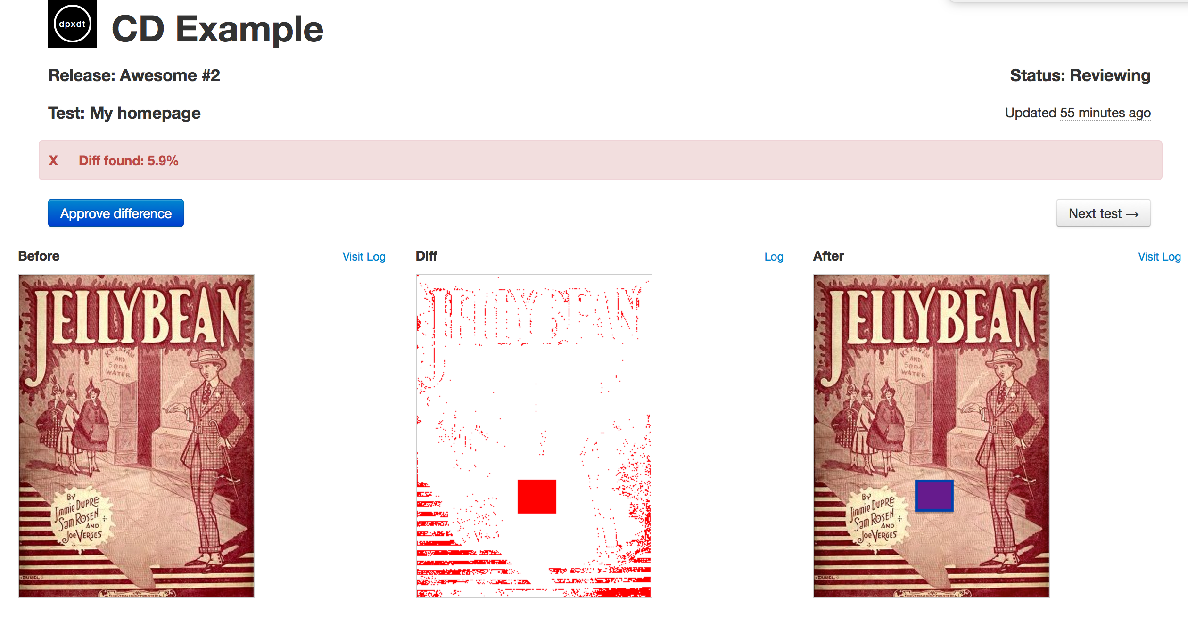
dpxdt
Notes:
Much better visual representation.

Slide 48
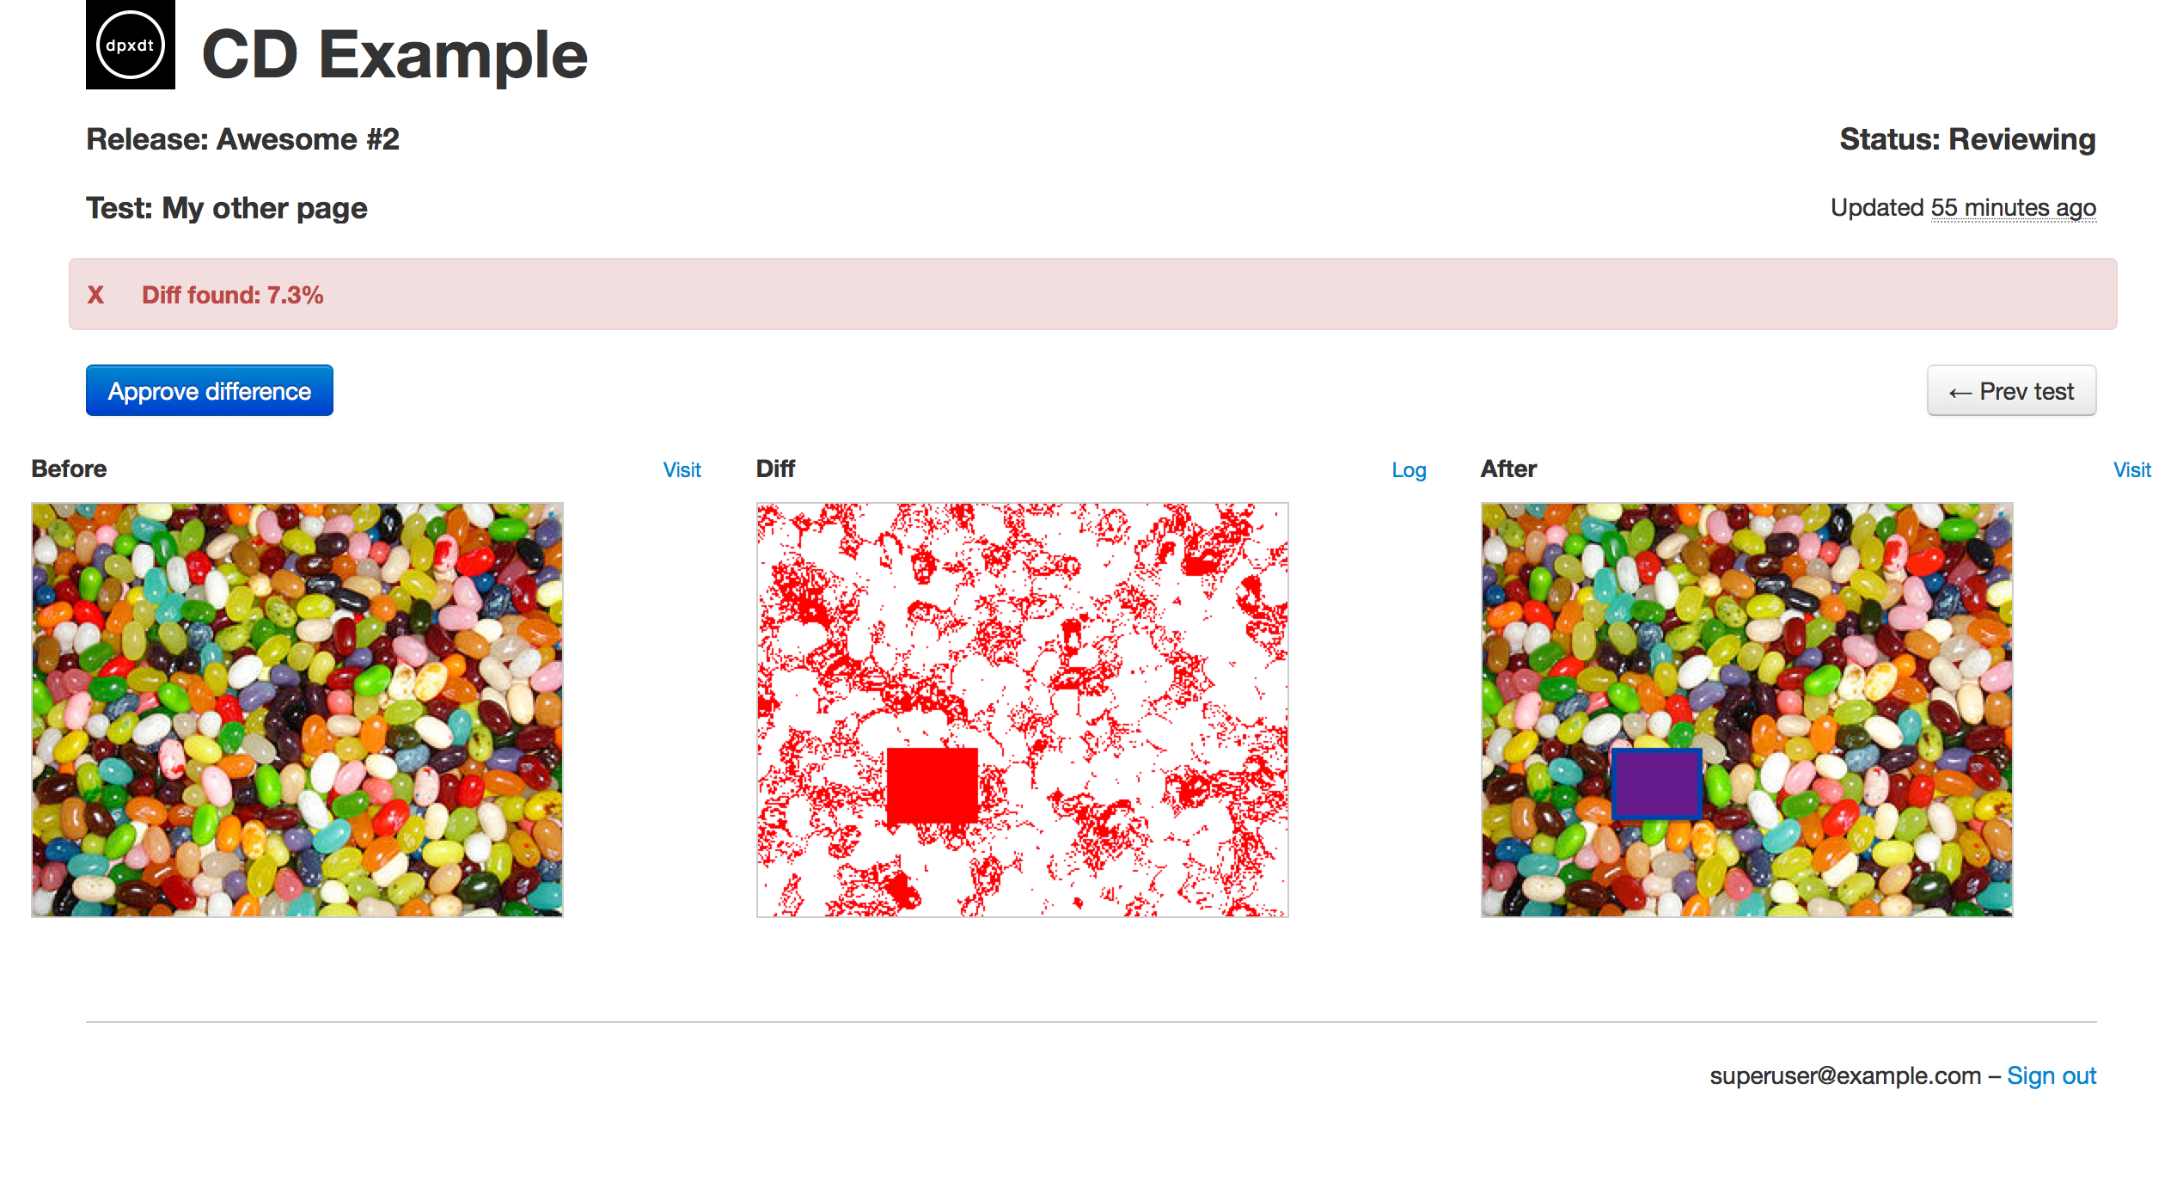
https://github.com/bslatkin/dpxdt

Slide 49
Points
Test locally matching production as much as possible
Everything in Source Control
Agree as a team on Branching standards
Have good tests and coverage
Fix the build right away
Make things visible
Automate your release process
Stage exactly like production
Use perceptual diffs

Slide 50
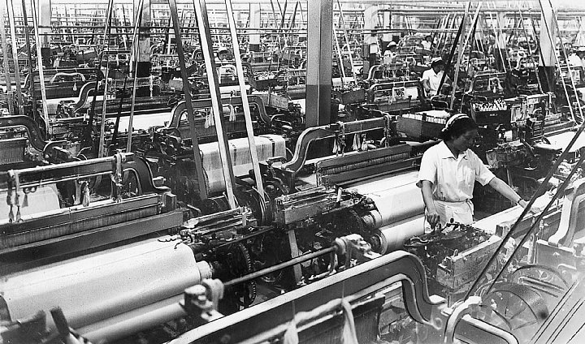
Toyoda
Notes:
Before they made cars, Toyota made looms. What they did different than everyone else was that the operator to machine ratio was not 1:1. The machines were fully automated and only operated on if something went wrong. This is referred to as Autonomation or Jidoka - automation with a human touch.

Slide 51
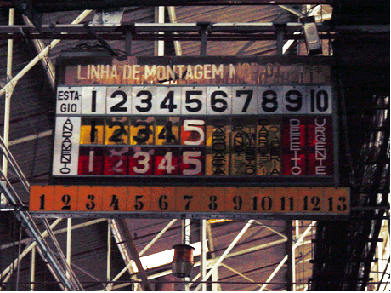
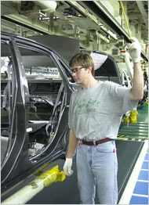
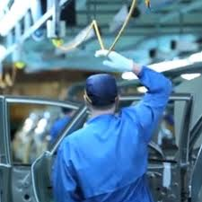
Andon Cord
Notes:
http://www.lean.org/shook/DisplayObject.cfm?o=1166
Many believe that this will stop the entire line. It will not but it does mean that a plant supervisor will get to your concern within the shift.

Slide 52
Points
Test locally matching production as much as possible
Everything in Source Control
Agree as a team on Branching standards
Have good tests and coverage
Fix the build right away
Make things visible
Automate your release process
Stage exactly like production
Use perceptual diffs
Trust and value your people
Notes:
People want more than anything else to be heard. The quickest way to ruin your work force is to stop listening.

Slide 53
Deploy to Production
http://deploy-demo.hearst.at/

Slide 54
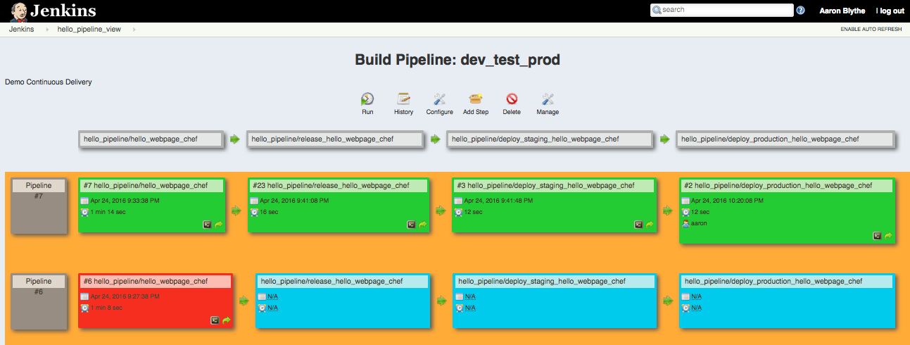
Deploy to Production

Slide 55
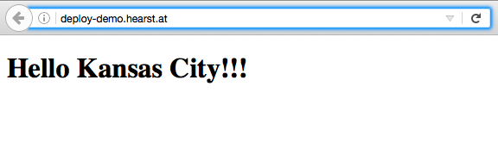
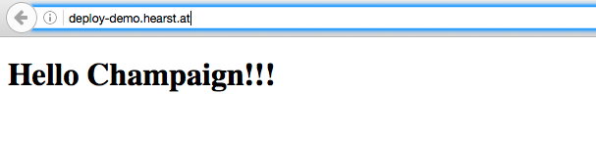
Deploy to Production

Slide 56
Recap
Test locally matching production as much as possible
Everything in Source Control
Agree as a team on Branching standards
Have good tests and coverage
Fix the build right away
Make things visible
Automate your release process
Stage exactly like production
Use perceptual diffs
Trust and value your people

Slide 57
Scoped Out of This Talk
It should always be cheaper to spin up a new environment than fix an existing one
Blue-Green Deployments
Orchestration of Multiple Nodes
12 Factor App
Container Scheduling
Heroku
Notes:
I work with big companies that have existing applications that make a lot of money. They are not immediately ready for micro services, containers and re-writing their apps. However to get the space they need in ops automation of their current system/process is paramount. They also have regulations that they believe at this point keep them out of many cloud tools. We work through that a step at a time.

Slide 58
Points
Test locally matching production as much as possible
Everything in Source Control
Agree as a team on Branching standards
Have good tests and coverage
Fix the build right away
Make things visible
Automate your release process
Stage exactly like production
Use perceptual diffs
Trust and value your people

Slide 59
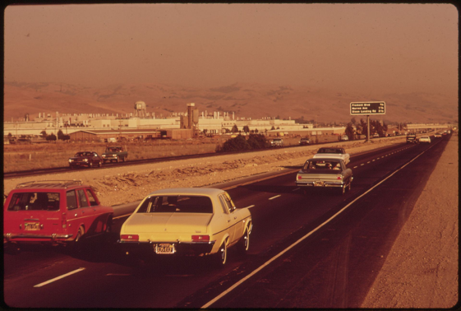
Fremont Assembly Plant
Notes:
Fremont Assembly Plant - Ran by General Motors or GM.
A 411-acre manufacturing plant in California.
At the time of its closure, the Fremont employees were "considered the worst workforce in the automobile industry in the United States", according to the United Auto Workers.[6][7] Employees drank alcohol on the job, were frequently absent (enough so that the production line couldn't be started), and even committed petty acts of sabotage such as putting "Coke bottles inside the door panels, so they'd rattle and annoy the customer."

Slide 60

NUMMI plant
http://www.lean.org/shook/DisplayObject.cfm?o=1166
Notes:
In spite of the history and reputation, when NUMMI reopened the factory for production in 1984, most of the troublesome GM workforce was rehired, with some sent to Japan to learn the Toyota Production System.[6][7] Workers who made the transition identified the emphasis on quality and teamwork by Toyota management as what motivated a change in work ethic. almost right away, the NUMMI factory was producing cars with as few defects per 100 vehicles as those produced in Japan.

Slide 61

Tesla Factory
Notes:
Coincidentally, this historic NUMMI plant is now the home of Tesla. The electric car manufacturer that open sourced to a degree their designs and patents recently that may change the world of car manufacturing. Tesla as you may know discarded the idea of model long ago and moves faster than Toyota using a continuous model where consumers can download updates to get new features.

Slide 62



Slide 63
Points
Test locally matching production as much as possible
Everything in Source Control
Agree as a team on Branching standards
Have good tests and coverage
Fix the build right away
Make things visible
Automate your release process
Stage exactly like production
Use perceptual diffs
Trust and value your people

